Slide 1

CPSC1517 Introduction to Application Development
Using the Debugging Tools
C#

Slide 2
Learning Outcome Guide
At the end of this topic, you should be able to
(Understanding/Knowledge)
Describe the role of debugging tools in software development
[Debugging tools help the developer in finding and fixing run-time logical errors in an application]
Explain how to use breakpoints to pause program execution at a specific location of code
Explain what is meant by the phrase “yellow screen of death”
List common types of run-time errors
Identify how to edit the configuration file (web.config) to enable or disable debugging
Describe the difference between “Step Into”, “Step Over” and “Step Out” in the debugger
(Ability)
Identify and fix run-time errors in an application using the debugging tools
Use the debugging tools to step through code
Use the locals and watch windows to examine the current state of variables and objects at run-time
Use the immediate window to make changes to or examine objects at run-time

Slide 3
Debugging Rules of Thumb
Rule of Thumb
When “it doesn’t work” then it’s probably a TYPO
If it’s not a typo, then it might be something you don’t fully understand…
This isn’t a “put-down” – it’s just a statement.
Expect to learn about stuff you think you already know.

Slide 4
Sample Coding Errors
Cut & Paste Paper-Cuts
Property Get/Set not using correct field
Demo-Lition – Copying code samples when it would have been better (& faster!) to type it from scratch
Mistaking Intelli-sense for Intelligence
Intelli-sense does not tell you what to type
Intelli-sense does tell you what exists in the code-base
Type Conversions
String Concatenation – forgetting .ToString() when using the plus (+) operator to do concatenation
Integer/Double/Date values – forgetting to check the data type of TextBox values before using them
Argument/Parameter Mismatch
Not sending the arguments in the order required by the parameter list
Constructor Routing Errors
Constructor not routing values through the Set properties, when present
Spelling error on parameter variable causes “do-nothing” value assignment in constructor’s body
Null Object Reference
An attempt to use a property or method on an object that doesn’t exist
Looping Logic Errors
Looping too many times
Looping too few times
Infinite loop

Slide 5
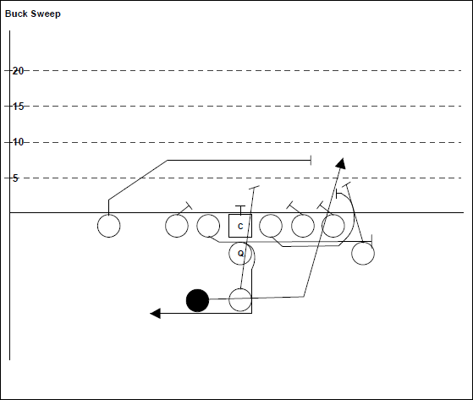
Follow the Flow of Execution
Slow Motion Replays
Football players will watch videos of how they executed certain plays in order to compare that to how the expected the play to work.
We can do the same using debugging tools
Notes:
Analogy – In football, when the play starts, it does so by one of the linemen hiking the ball to the quarterback. The quarterback then either passes or hands off the ball to someone else (or runs with it). Passing the ball is what happens with information in a computer program, and it must happen just right, or it won’t happen at all (like the football play).
When debugging, you get to follow the flow of program execution step-by-step

Slide 6
Demo

Slide 7
Questions and Answers

Slide 8
Exercises
Using the Debugging Tools

Slide 9
1) Try it Yourself
Use the demo yourself to step through and find all the logic errors in the program.

